Slide 1


MINOR PROJECT REVIEW
By :
Naveen M ( 927622BME057)
Nesamani S ( 927622BME058)
Nishanth S ( 927622BME059)
Guided by:
Mrs.D.Umamaheswari

Slide 2
ELECTRIC POWER USING EXHAUST HEAT

Slide 3
PROJECT OBJECTIVE
The design of waste heat recovery system that aims to generate electric power by using the exhaust heat that produced from an internal combustion engine. Experimental studies were conducted to achieve electricity generation by the thermoelectric generator (TEG). However, by this electrical generated we can utilize many applications such as charging battery or run some electronic components.

Slide 4
APPLICATION
This can be used on the two wheelers to convert the heat energy from the exhaust into electrical energy.
We can directly connect the electrical supply to the main battery of an motorcycle, which will increase the efficiency of the battery and it will long last for more years than the battery life.
We can also separately add an small battery to the bike and utilize it for making electric horns which is more efficient and charging ports for mobiles.

Slide 5
Type of TEG used for LMV’s
There are three types of TEG’s available for research,are:
Low Temp TEG
Medium Temp TEG
High Temp TEG
The low Temp TEG will be used in our project, because it can able to resist the temp of 100-300°C, however the bike can produce the maximum temp of 120- 280°C.
It will produce an estimated Power Output of 200-400mW at 200°C

Slide 6
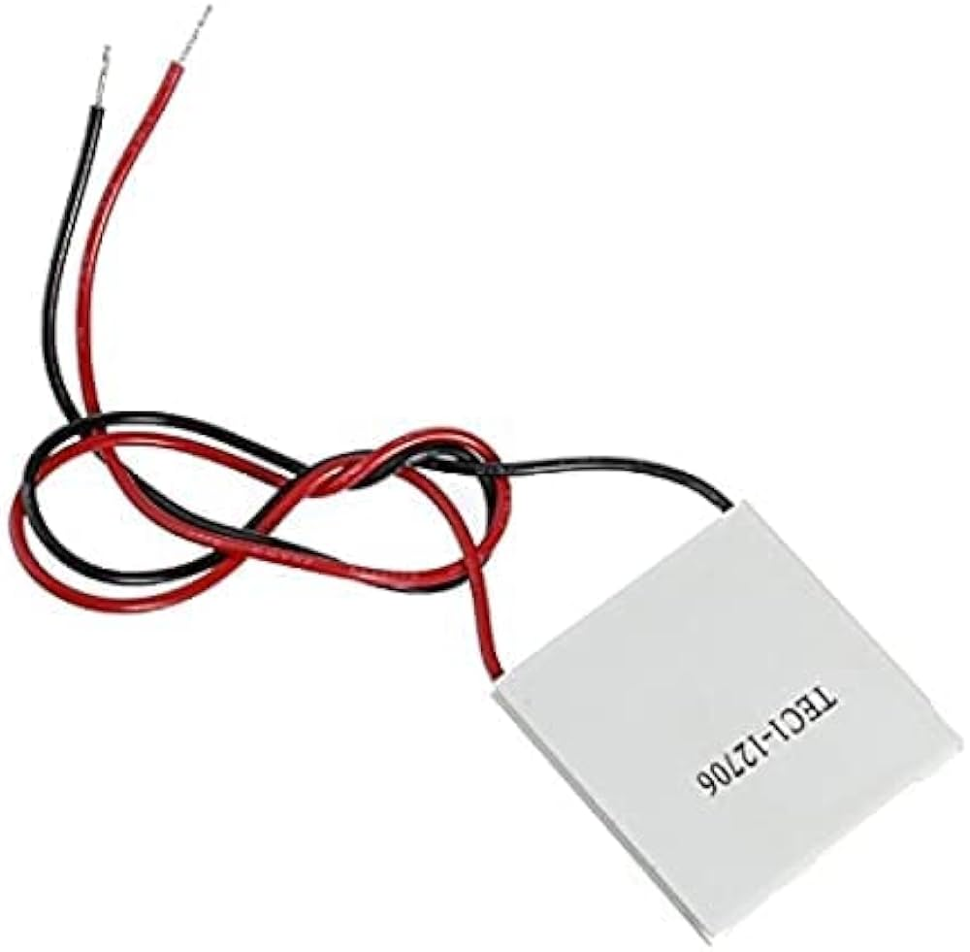
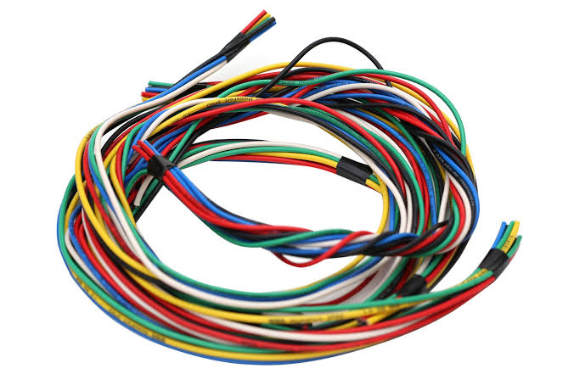

MATERIALS
1.TEG SP1848-27145
3.WIRES
Model: SP1848-27145.
Open Circuit Voltage: 4.8V.
Operating Temperature: 0 to 150°C.
Maximum Temperature: 150°C.
Wire Length: 350mm.Size:40mm*40mm*3.6mm
(L*W*H)
PRICE : 399Rs - 599Rs
PRICE : 100Rs
2.BATTERY
COST ESTIMATION
10V Battery
PRICE : 500Rs – 700Rs
The Cost estimation will around 1299Rs to 1799Rs.

Slide 7
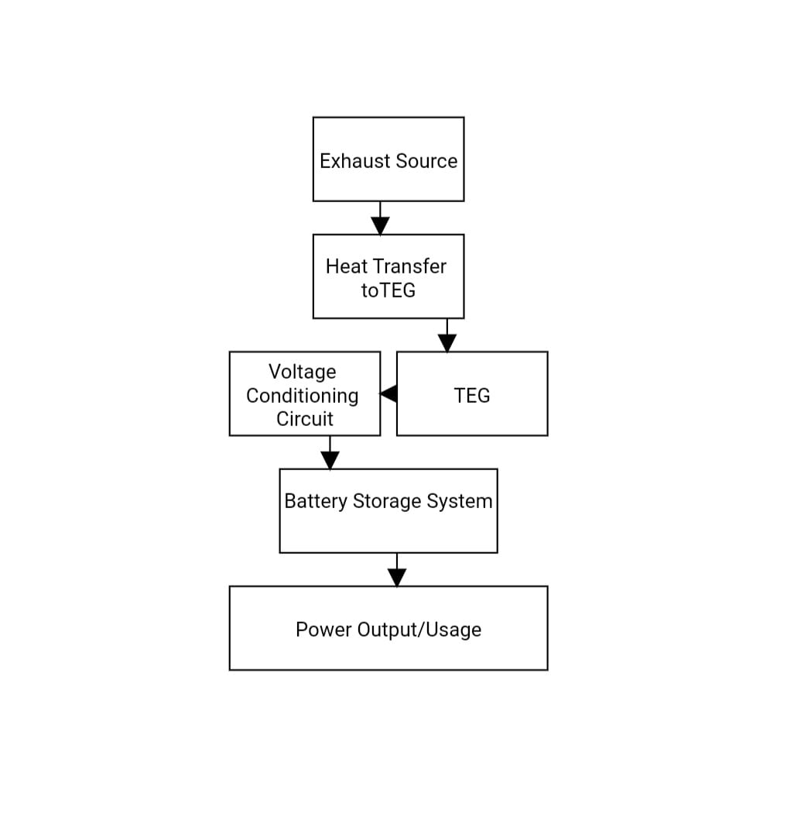
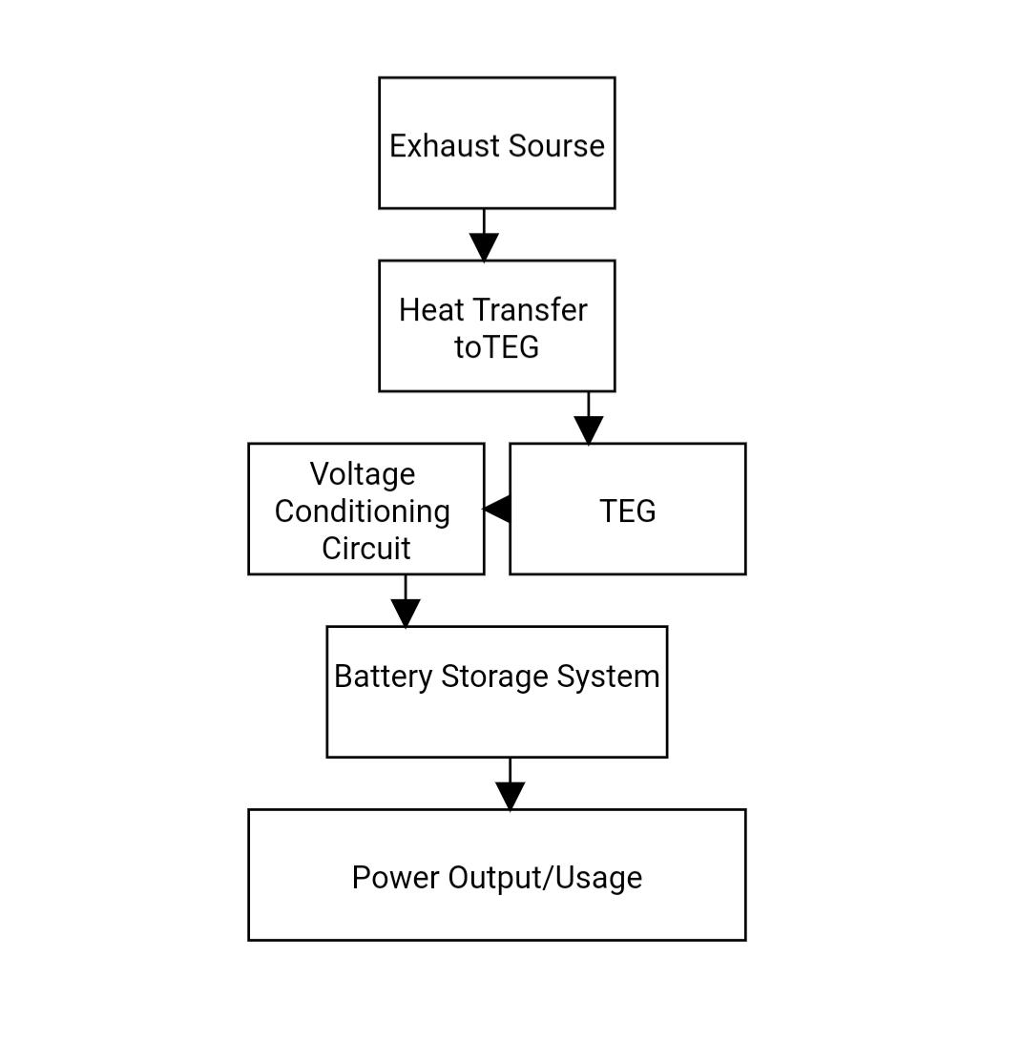
BLOCK DIAGRAM
source

Slide 8
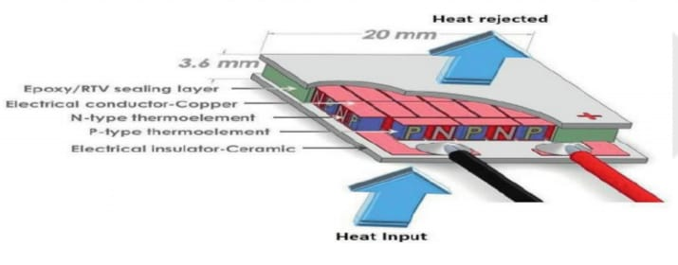
WORKING OF TEG
Heat Input and Heat Rejection: Heat is applied
to one side of the TEG, creating a
temperature difference. The other
side releases excess heat,
maintaining the gradient.
P-type and N-type Thermoelements: These are thermoelectric materials with opposite charge carriers (holes for P-type, electrons for N-type). Alternating P and N materials enhance the thermoelectric effect, as electrons and holes flow in opposite directions.
Epoxy/RTV Sealing Layer: Protects internal components from external environmental factors.

Slide 9
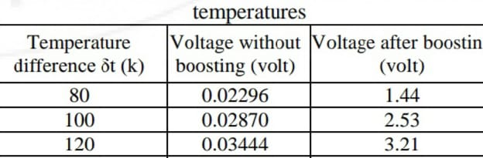
VOLTAGE CALCULATION
Seebeck Effect Equation : V = α (Th - Tc)
α of Bismuth Telluride : 287 × 10^(-6)V/K
Th - Kelvin of the hot place temperature (silencer) [Approx=403 k or 130°C]
Tc - Kelvin temperature of cold place (atmosphere) [Approx=303 k or 30°C]
Th= 403k, V=Original Voltage Generated
V= (287 × 10^(-6) )* (403-303)
= (287 × 10^(-6)) *(100)
V= 0.0287

Slide 10
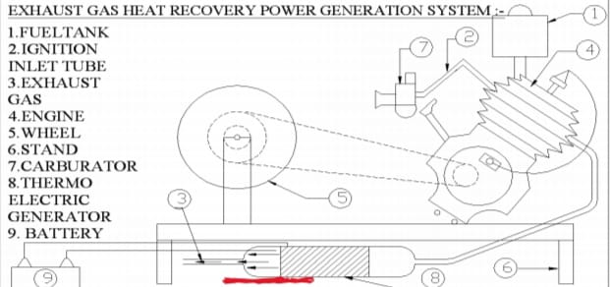
WORKING MODEL

Slide 11
ADVANTAGES
Charging Phones
GPS devices
Powering bike lights or auxiliary lights
Charging Power banks for Emergency use
Energy Harvesting

Slide 12
PROJECT OVERVIEW
To design a system that operates at a high temperature engine exhaust to generate free electricity.
The conversion of waste heat into free electricity by using thermoelectric generators and make it usable.
To develop a power generation method the every source of energy.
Maintain the heat transfer from hot side to cold side of the system in order to make it more efficient.

Slide 13
REFERENCE
1.Use of exhaust heat energy of two wheelers to generate power by seebeck effect Shubham Suryawanshi, Manasi Sonawane, Arpit Sharma, Shraddha Kshirsagar, Vivek Diware Student, Department of Mechanical Engineering, DY Patil College of Engineering, Maharashtra, India
2. Some YouTube Videos to know more about this project.

Slide 14
THANK YOU

